Slide 1
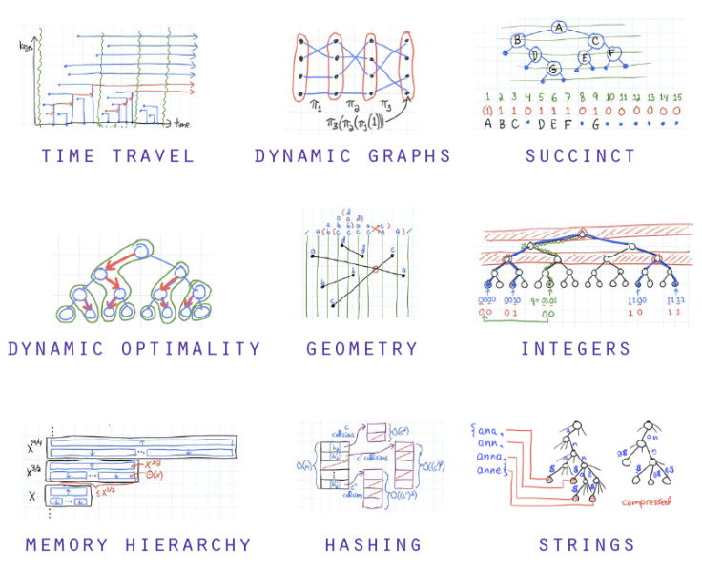
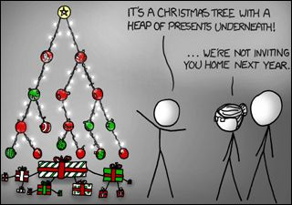

Python
Advanced Data Structures
Peter Wad Sackett

Slide 2
Designing the data structure to fit your need
Modeling reality
By designing the right data structure for the problem the code becomes much easier to create.
Python’s object model makes it easy to create any data structure.
A data object can be almost any place where a simple value can be.
Simple values are strings and numbers.
More complex objects are lists, dicts and sets.
For example lists can be inside lists, similar to the way for loops can be inside for loops.

Slide 3
Lists of lists
Creating a list of lists, intuitive use is matrix
matrix = [[1, 2, 3], [4, 5, 6], [7, 8, 9], [10, 11, 12]]
Accessing a row and a single number
print(matrix[1], matrix[2][2])
matrix[0][0] = 0
Adding a row
matrix += [[13, 14, 15]]
Adding a column (list must match the matrix height)
for number in enumerate([3, 6, 9, 12, 15]):
matrix[number[0]].append(number[1])
Printing the numbers in the matrix – one per line
for row in range(len(matrix)):
for column in range(len(matrix[row])):
print(matrix[row][column])

Slide 4
Dicts of dicts
The king of flexibility – example of protein-protein interactions
ppi = {”prot_a”: {”prot_b”: ”strong”, ”prot_c”: ”weak”},
”prot_b”: {”prot_a”: ”strong”, ”prot_c”: ”none”},
”prot_c”: {”prot_a”: ”weak”, ”prot_b”: ”none”}}
print(ppi[”prot_b”], ppi[”prot_b”][”prot_a”])
Adding a primary key/value pair
ppi[”prot_x”] = {”prot_a”: ”none”, ”prot_b”: ”strong”}
or
ppi[”prot_x”] = dict()
ppi[”prot_x”][”prot_a”] = ”none”
ppi[”prot_x”][”prot_b”] = ”strong”
Iterating over dict of dicts
for priKey in ppi:
for secKey in ppi[priKey]:
print(priKey, secKey, ppi[priKey][secKey])

Slide 5
Dicts of lists
An example could be to hold people’s scores
scores = {’Ann’: [7, 10, 4, 2], ’Dave’: [2, 7, 7, 10]}
Accessing all of Ann’s and a single of Dave’s scores
print(scores[’Ann’], scores[’Dave’][2])
Adding a new person and a single score for Ann
scores[’Mia’] = [4, 4, 2, 2]
scores[’Ann’] += [7]
Iteration
for person in scores:
for score in scores[person]:
print(person, score)

Slide 6
A more interesting and diverse structure - human
Designing an extendable data structure that can model a human.
human = {
’firstName’: ’Peter’,
’lastName’: ’Sackett’,
’children’: [’Marcus’, ’Freya’],
’jobs’: {’web designer’: [1995, 2000], ’teacher’: [2000, 2016]}
}
The structure can be a irregular as wanted/needed.
Imagine a list of these.
Adding a job.
human[’jobs’][’president’] = [2020, 2025]

Slide 7
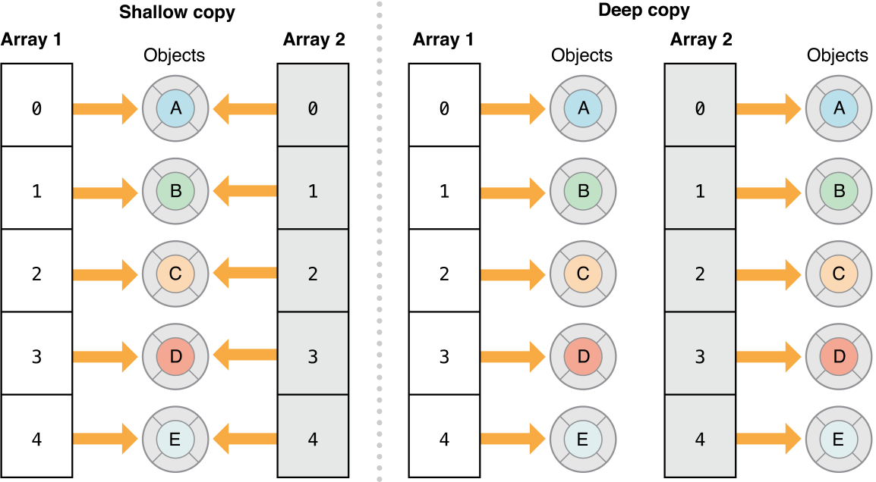
Danger – copying advanced data structures
Whenever you copy an advanced data structure, you make a shallow copy.
Consider if you need a deep copy instead (real copy).

Slide 8
Deep copy vs shallow copy
Making copies in python, using the library.
import copy
mat = [[1,2,3],[4,5,6],[7,8,9]]
# making a shallow copy of mat, existing rows are shared
shallow_mat = mat
# or
shallow2_mat = copy.copy(mat)
# making a deep copy of mat, nothing is shared
deep_mat = copy.deepcopy(mat)
Shallow copy pros: Quick, uses much less memory.
Shallow copy cons: Changes in the copy are reflected in the original.
Warning: Many programs have failed in strange ways, because the data sharing was not considered.

